Slide 1
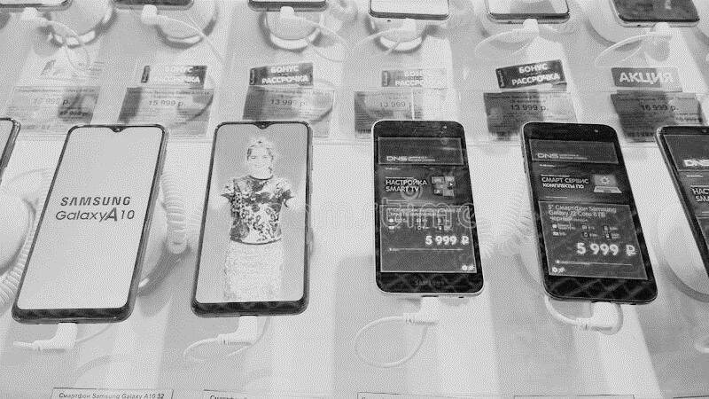
Capstone Project - 3
Mobile Price Range Prediction Rohit Madame

Slide 2
Content
Introduction
Problem Statement
Data Summary
Data Wrangling
EDA
Model selection and Evaluation
Comparing Different Models
Conclusion

Slide 3
Introduction
Mobile phone market is very competitive market .Mobile phones comes in all sort of prices , features, specifications etc. It is important for the customer to have a mobile price prediction as per their price range and best features.

Slide 4
Problem Statment
In the competitive mobile phone market companies want
to understand sales data of mobile phones and factors which drive the prices.
The objective is to find out some relation between features of a mobile phone(eg:- RAM,
Internal Memory, etc) and its selling price. In this problem, we do not have to predict the
actual price but a price range indicating how high the price is.

Slide 5
Data Summary
Battery_power - Total energy a battery can store in one time measured in mAh
Blue - Has bluetooth or not
Clock_speed - speed at which microprocessor executes instructions
Dual_sim - Has dual sim support or not
Fc - Front Camera mega pixels
Four_g - Has 4G or not
Int_memory - Internal Memory in Gigabytes
M_dep - Mobile Depth in cm
Mobile_wt - Weight of mobile phone
N_cores - Number of cores of processor

Slide 6
Pc - Primary Camera mega pixels
Px_height - Pixel Resolution Height
Px_width - Pixel Resolution Width
Ram - Random Access Memory in Mega Bytes
Sc_h - Screen Height of mobile in cm
Sc_w - Screen Width of mobile in cm
Talk_time - longest time that a single battery charge will last when you are
Three_g - Has 3G or not
Touch_screen - Has touch screen or not
Wifi - Has wifi or not
Price_range - This is the target variable with value of 0(low cost), 1(medium cost),
2(high cost) and 3(very high cost)

Slide 7
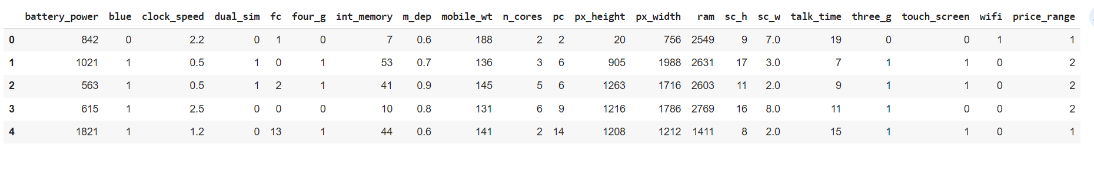
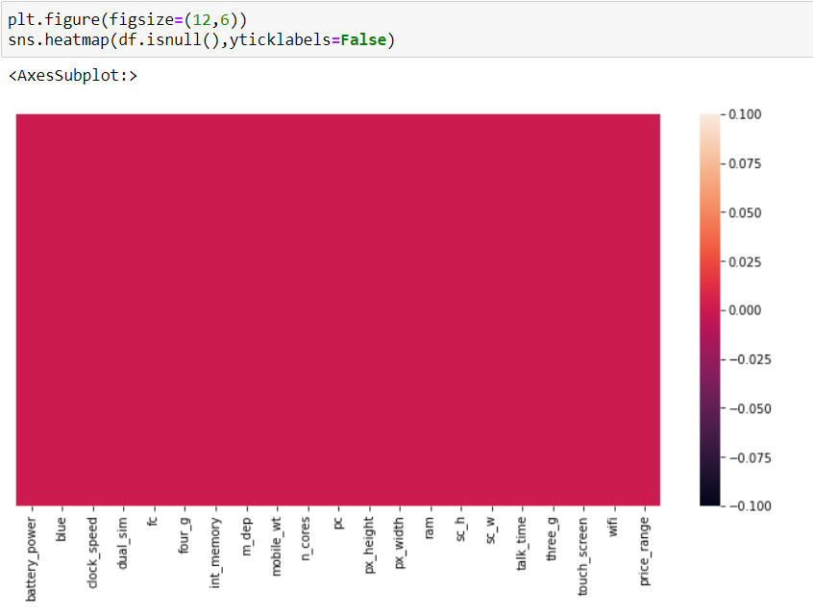
Data Wrangling
As we have checked for null values and duplicate values but we could not find in both.

Slide 8
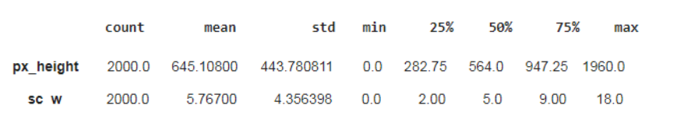
We found that screen width and pixel height has minimum value 0 which is practically not possible
So in screen width we have replaced it with mean value and pixel height has 0 value in only two rows so we dropped it.

Slide 9
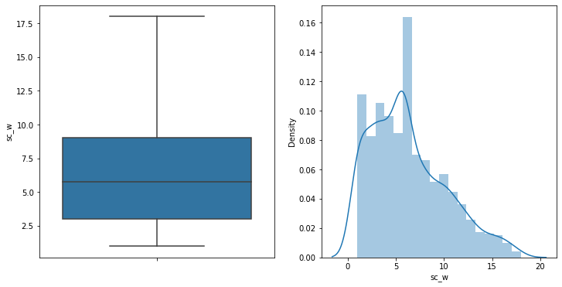
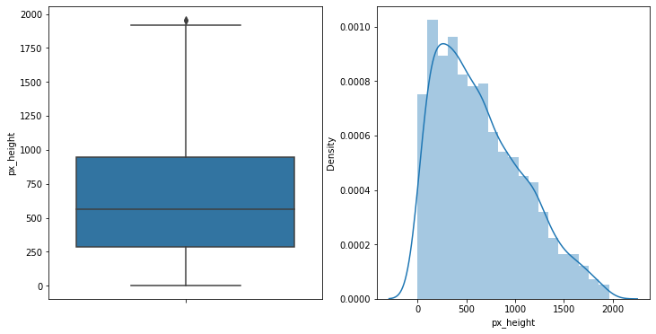
Exploratory Data Analysis
After replacing value of screen width and pixel height we get the following plot.

Slide 10
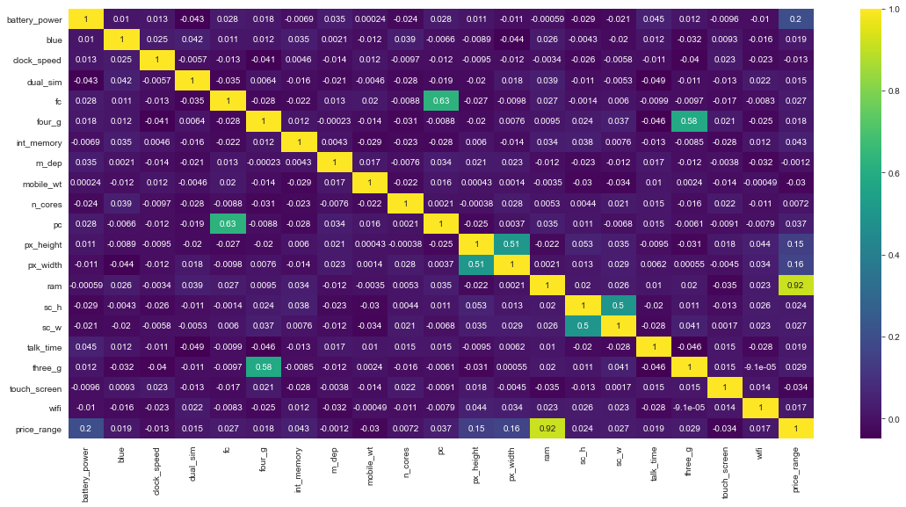
Heatmap show correlation of independent variable to dependant variable.
Ram, Battery_power, pixel height and pixel width are correlated with the price range.

Slide 11
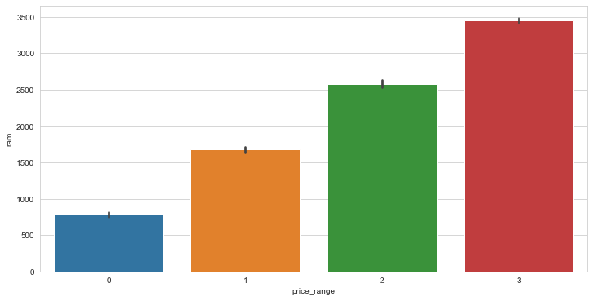
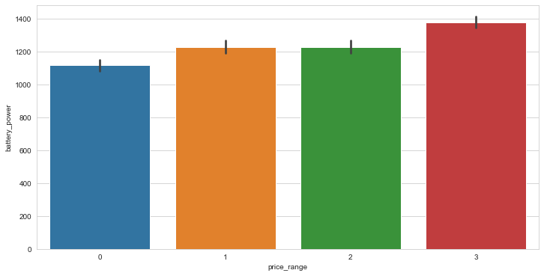
We can see that as ram increase the price range of mobile also increases.
Battery power between 1200 and 1300 mAh falls under price range of 1 and 2.For battery more than 1300 mAh has in to the very high cost price group.

Slide 12
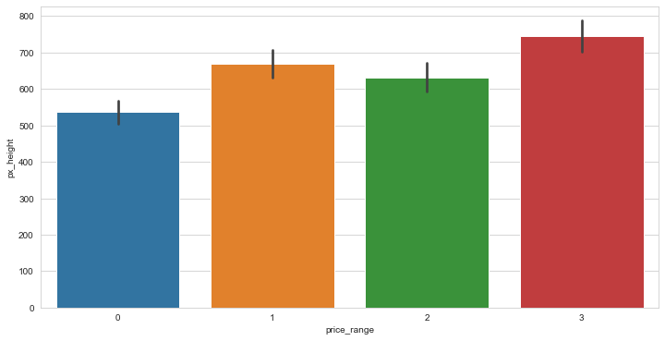
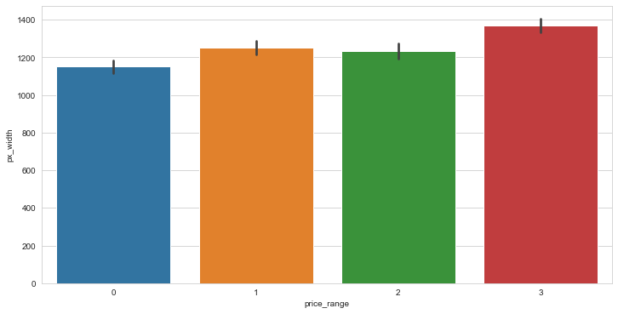
As pixel height higher than 700 falls into the very high cost price group and for less
than 700 it falls under medium cost.
For pixel width more than 1300 it is in the very high cost price group and for more than
1200 and less than 1300 it is in the 1 and 2 group

Slide 13
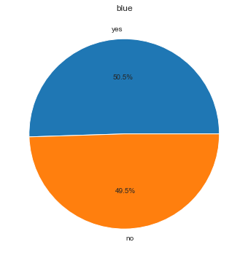
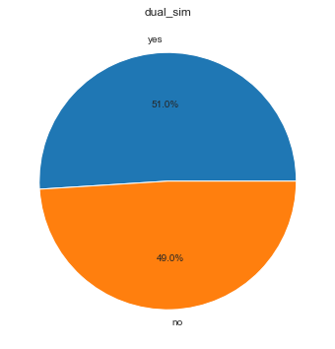
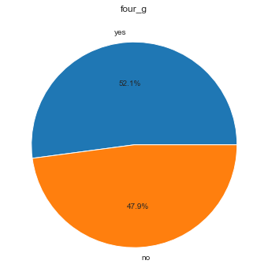
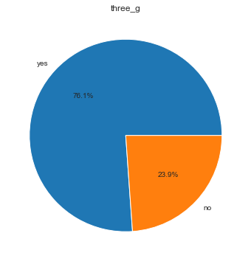
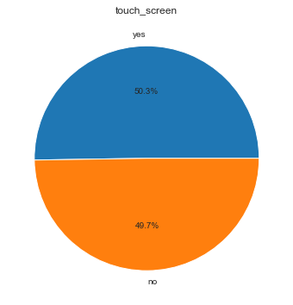
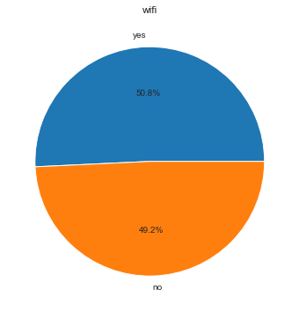
Distribution for Bluetooth ,dual sim ,four_g ,three_g ,touch_screen and wifi

Slide 14
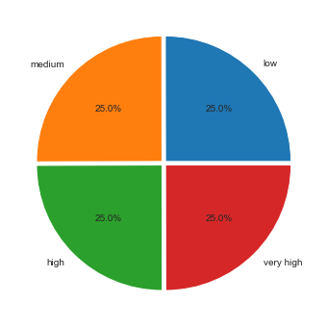
Plotting pie chart for Price range variable so we can conclude that it has
Equally distributed.

Slide 15
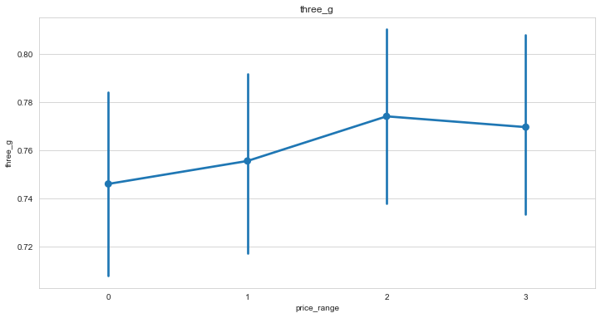
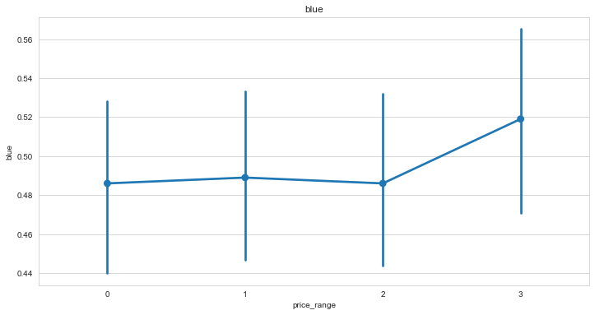
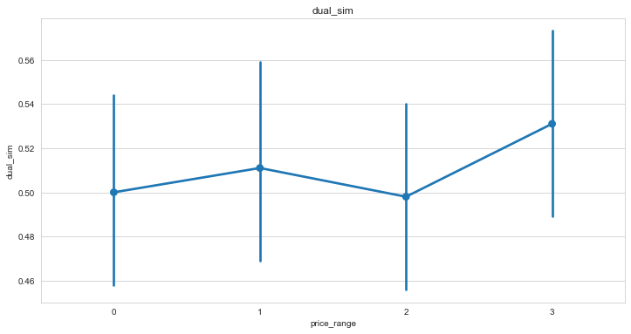
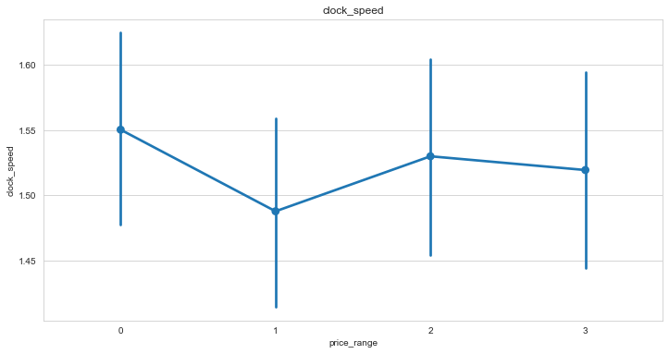
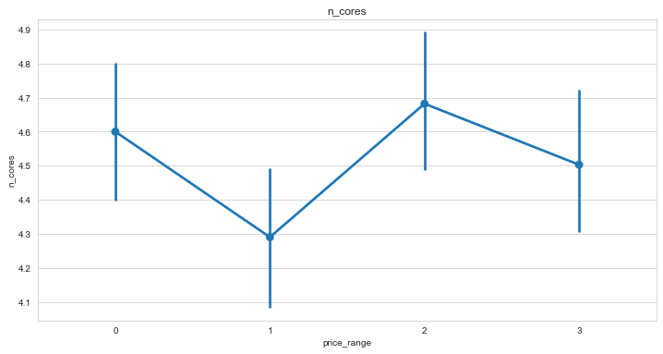
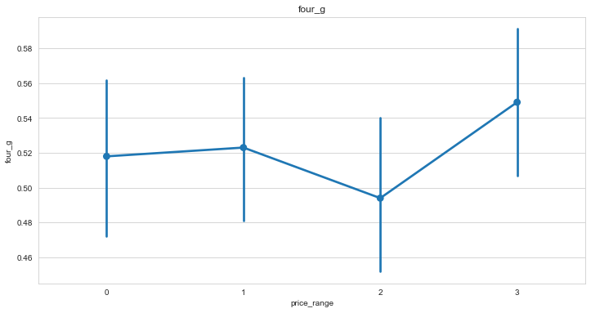
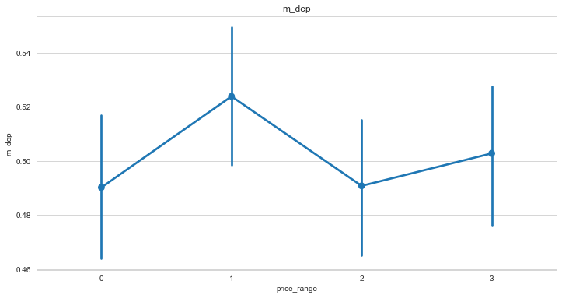
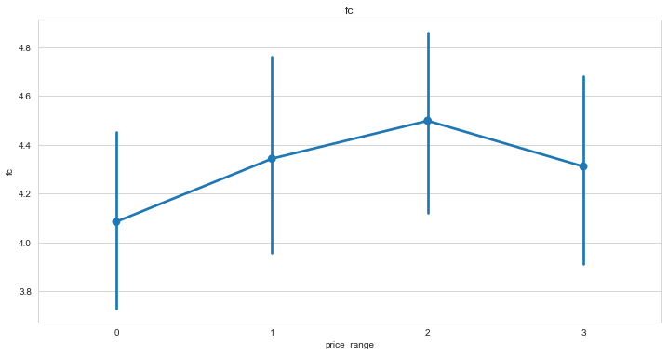
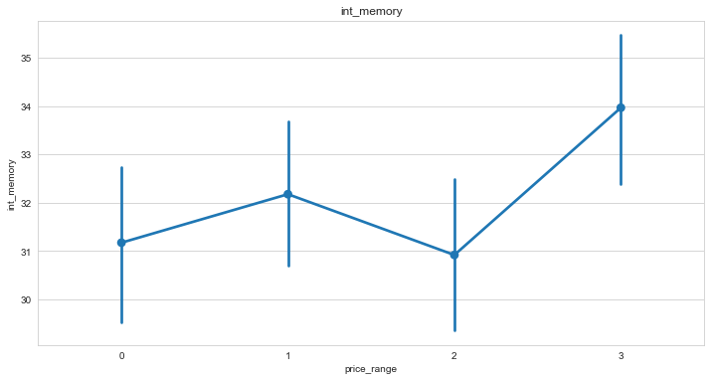
Plotting pointplot for dependant variable vs independent variable

Slide 16
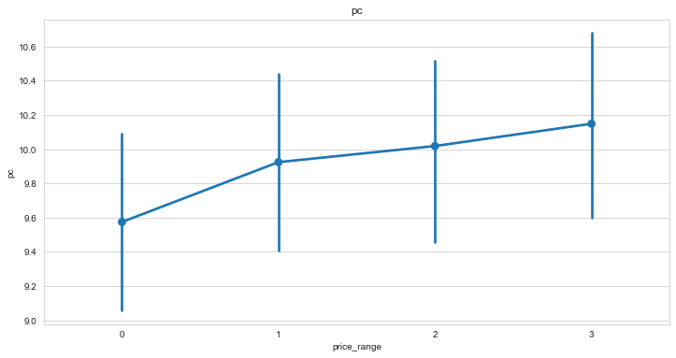
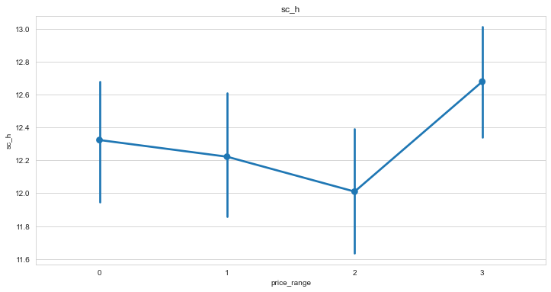
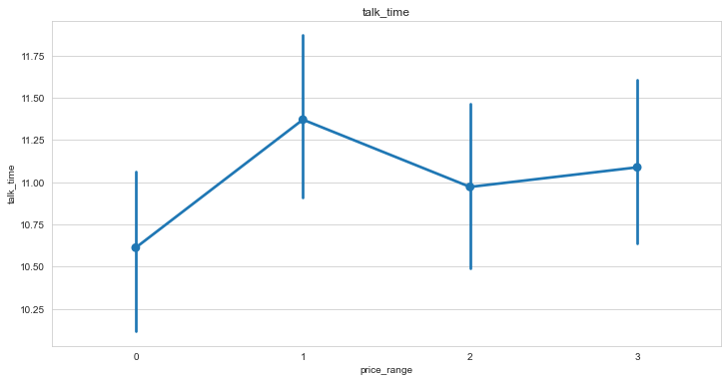
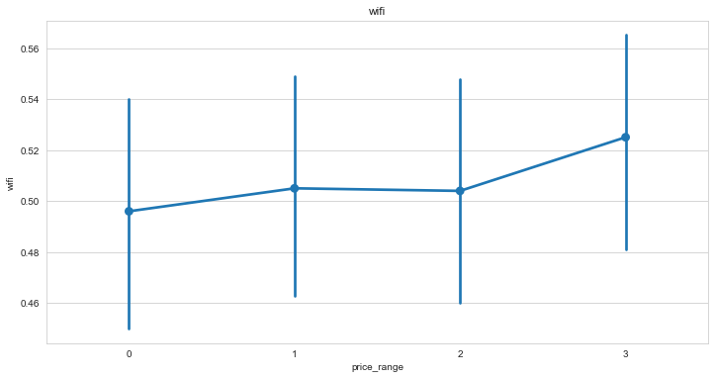
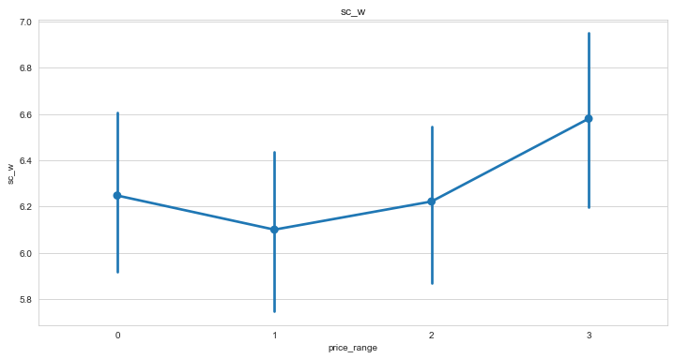
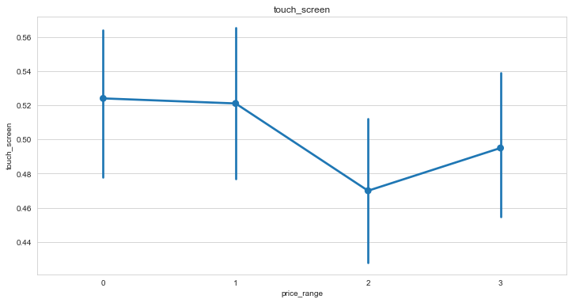
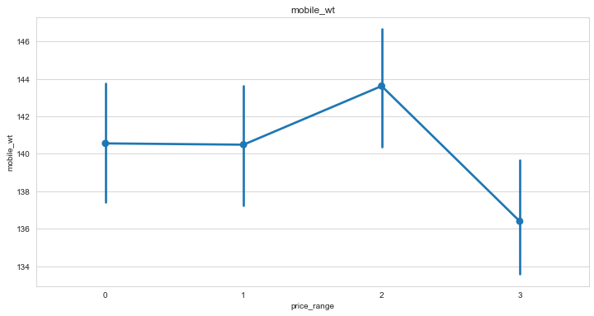

Slide 17
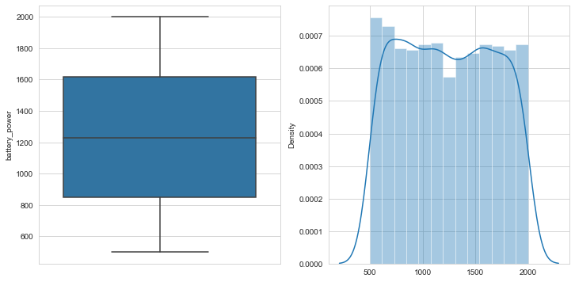
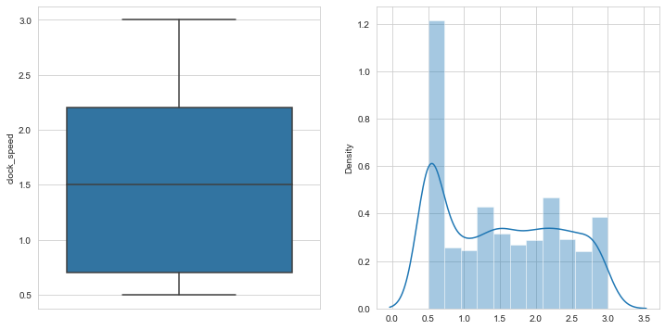
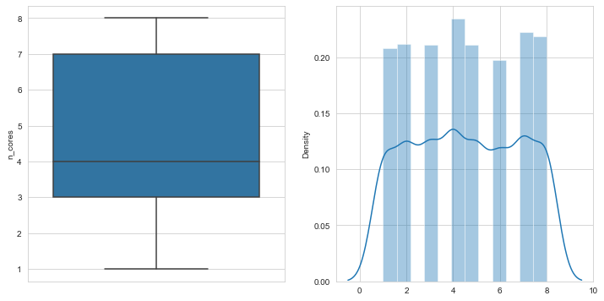
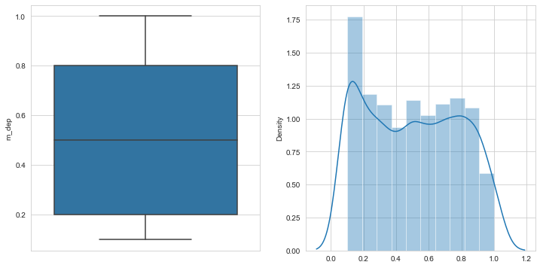
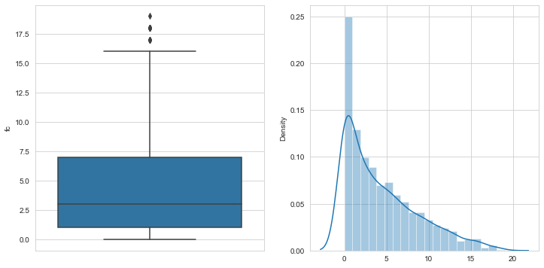
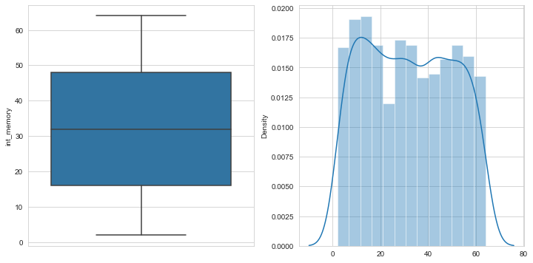
Checking outliers and distribution for numerical value.

Slide 18
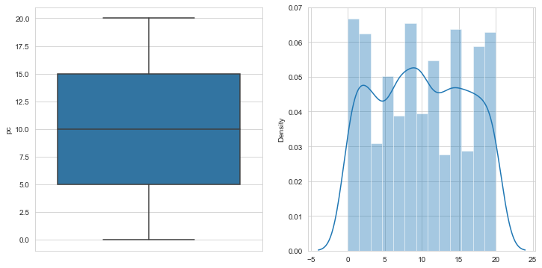
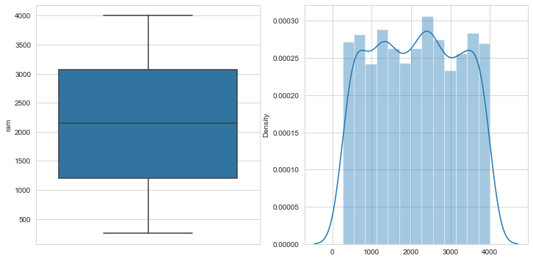
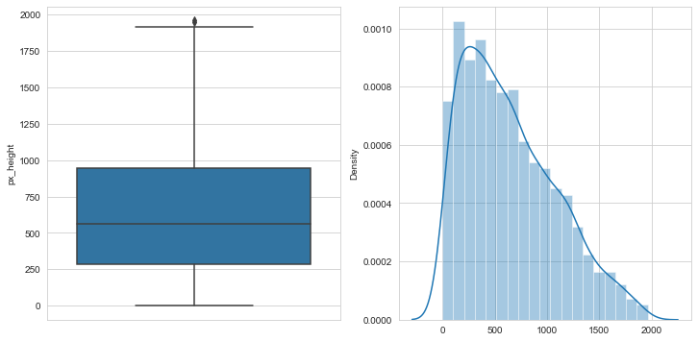
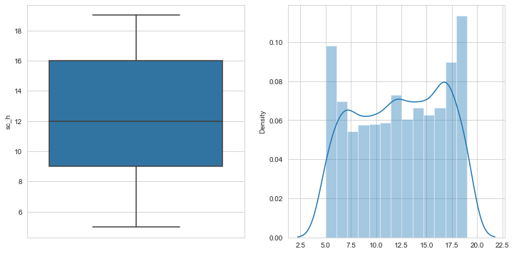
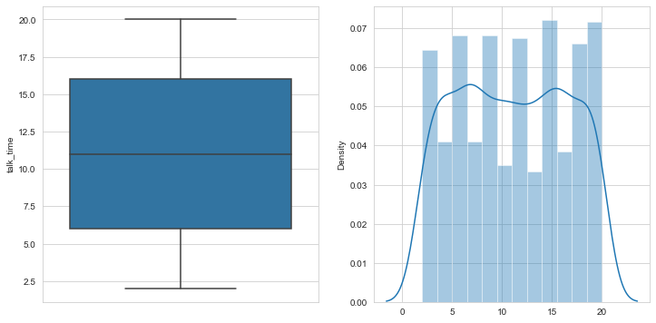
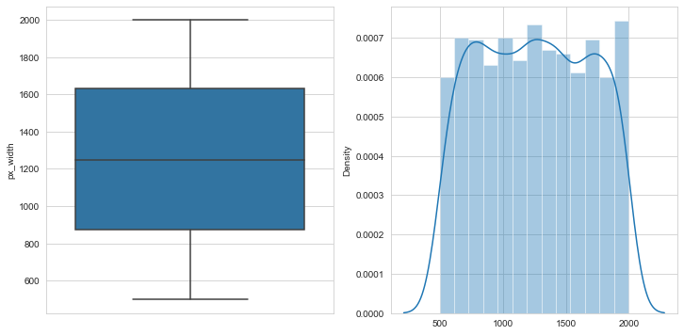
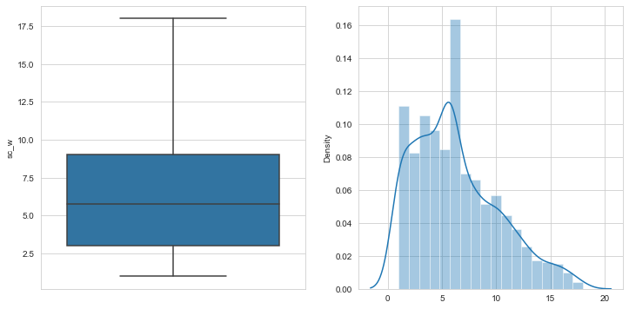
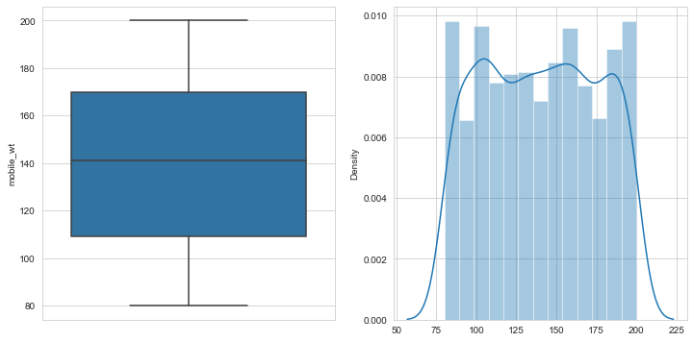

Slide 19
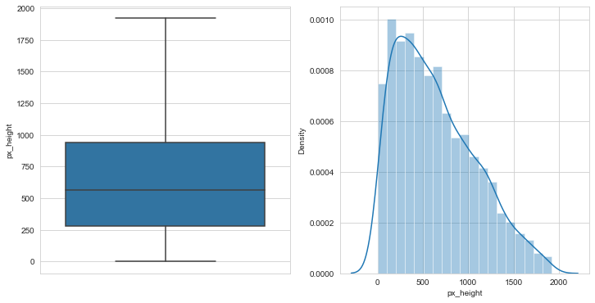
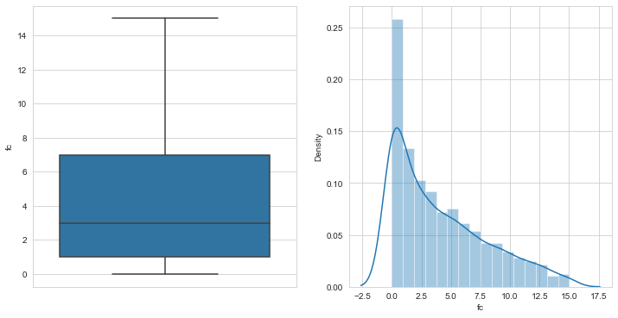
We removed outlier by IQR method. Upper_limit=Q3+1.5*IQR.
Where IQR=Q3-Q1

Slide 20
Model Selection and Evaluation
First we split the data into train and test data where we kept test data for 30% and 70% for train data.
We applied three models are as follows:
Gradient Boosting Classifier
Random Forest Classifier
KNeighbors Classifier

Slide 21
Comparing Different Models.
KNearestNeighbors has performed well and gave 91.82 % accuracy on test data.
KNearestNeighbors (Hyperparameter) ranked second with 90.97 %
Random Forest Classifier gave 87.65 which is not that good as compared to others.

Slide 22
Conclusion
As Ram increase the price range of mobile also increases.
As the primary camera increases the megapixels, the price range also increases.
KNearestNeighbors got the best accuracy where as Random Forest Classifier got least accuracy.
We have checked for the feature importance's of each model. RAM, Battery Power, pixel height and pixel width contributed the most while predicting the price range.

Slide 23
Thank You !

